Slide 1
GenAI – Dynamic Dashboard
07 July 2024

Slide 2
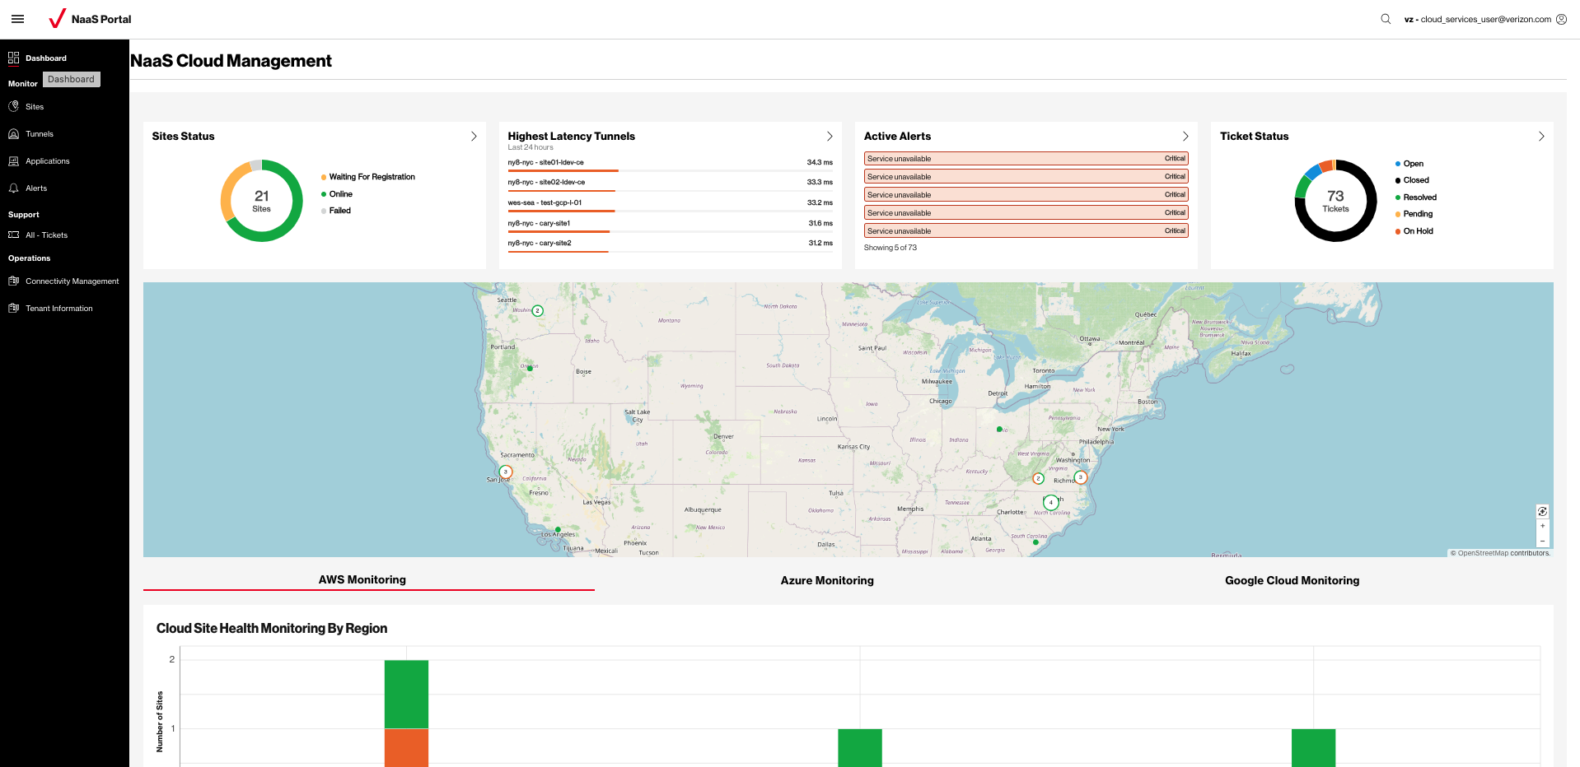
Customer NaaS portal

Slide 3
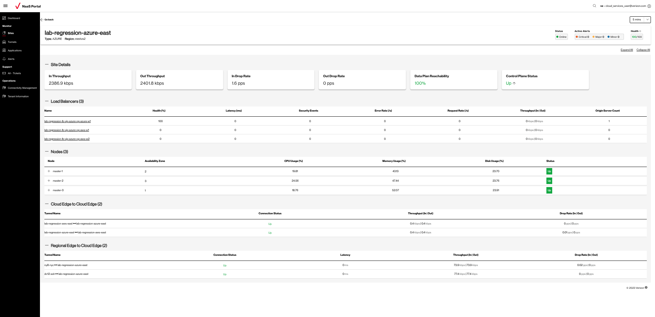

Slide 4
Solution Architecture

Slide 5




GenAI Chatbot : Automated code generation for visualizations and Inquiry handling
Business Problem
Enhance the NaaS portal's capabilities by integrating a chatbot to facilitate user interaction and analysis of network data.
The chatbot application must be capable of generating visualizations such as charts on-demand without manual coding.
Key Solution Features
Natural Language Understanding (NLU) capabilities enable the application to interact with users in a conversational, human-like manner, ensuring seamless query resolution and interaction.
Intelligent Data Retrieval by utilizing (LLMs) to formulate SQL or GraphQL queries dynamically to retrieve relevant data.
Interpret user queries, generate relevant visualizations appropriate for the user query using generative AI
>40%
Reduction in manual efforts
User Query
LLM
API Gateway
Generate SQL/ GraphQL Query
Classify if data retrieval required
Data
LLM
CLOUD
Yes
Run query & retrieve data
Casual conversation
LLM
No
Retrieved Data
Generate Copilot response and check if Visualization is required
Conversational Buffer Memory (store only last ‘K’ conversations)
Code generation Block
Generate a casual conversation response
LLM
Yes
No
Rule based
Generate visualization code
Return Response
Process HTML code
Process HTML code
Process HTML code
Code generation Block
Copilot Response
Render on Chatbot interface

Slide 6
Dynamic Dashboard UI Screenshots

Slide 7
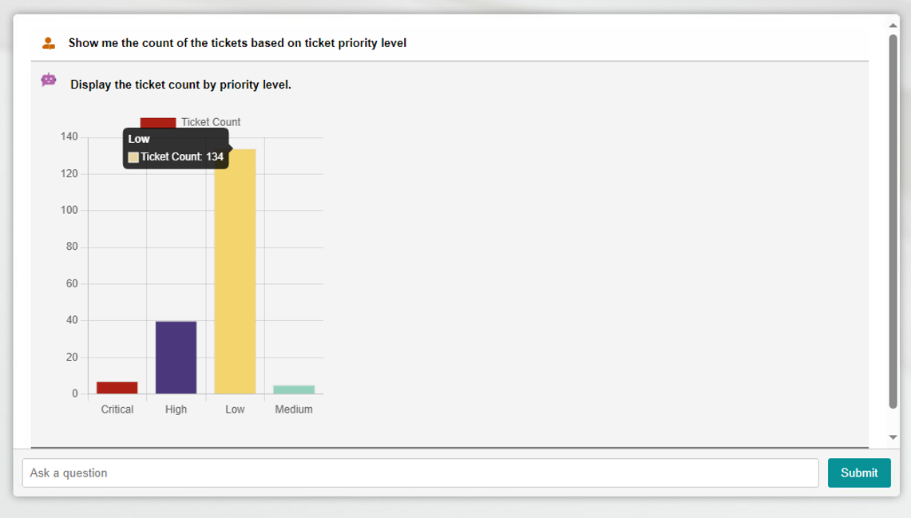
Chatbot UI Screenshots

Slide 8
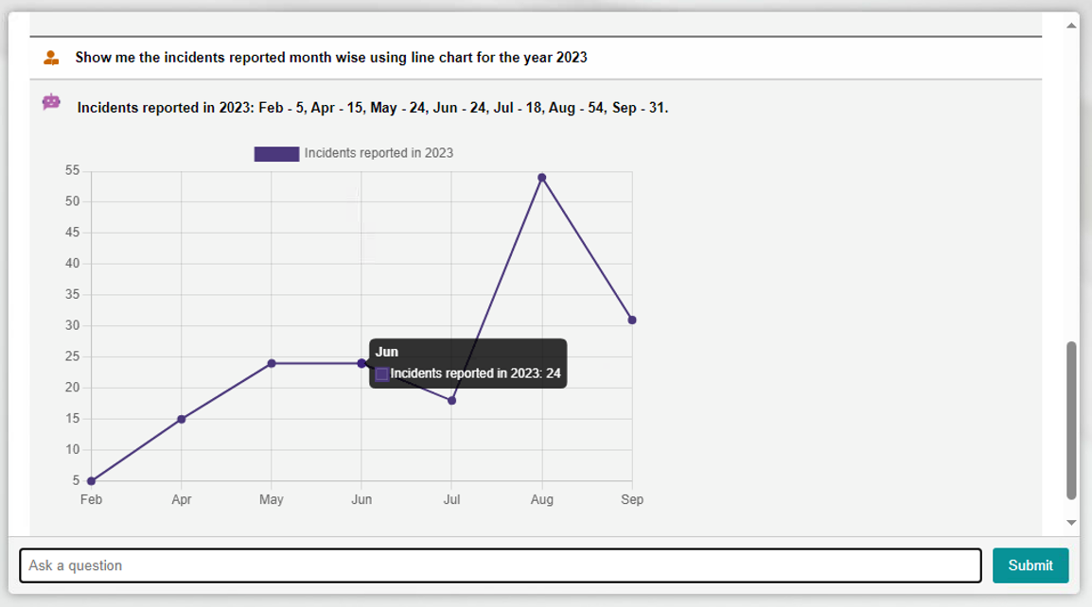
Chatbot UI Screenshots

Slide 9
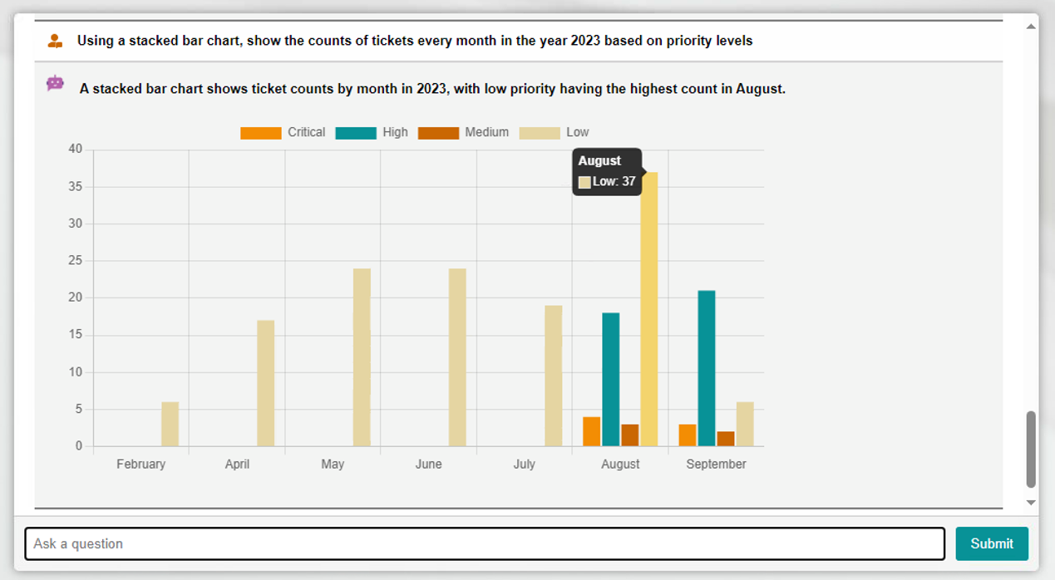
Chatbot UI Screenshots

Slide 10
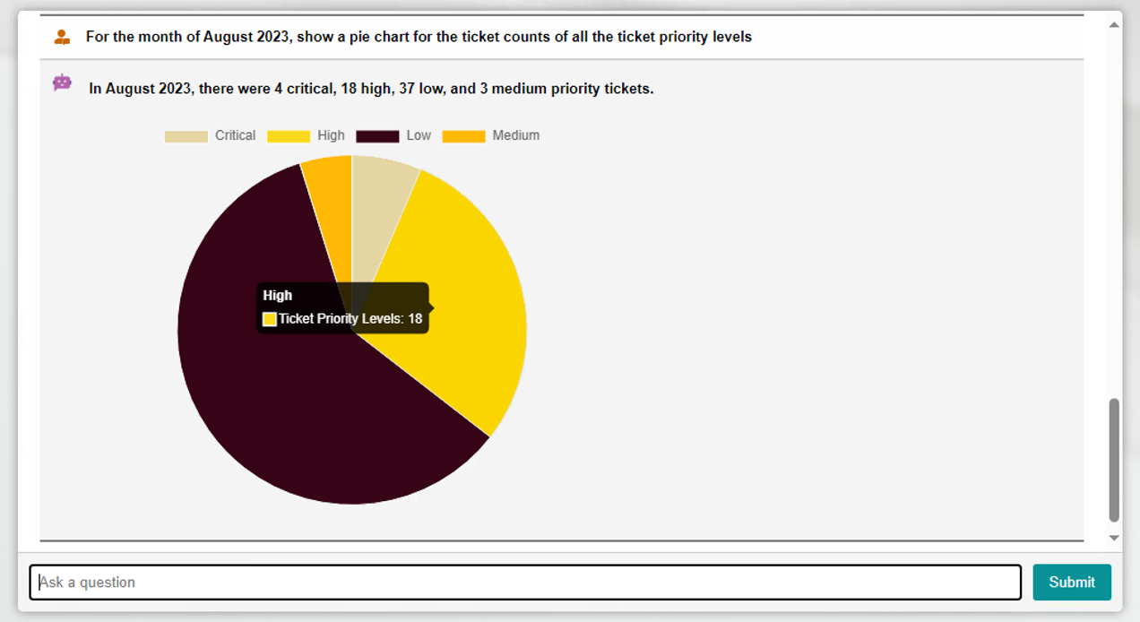
Chatbot UI Screenshots

